Slide 1
INTRODUCTION TO AI/MACHINE LEARNING
Artificial Intelligence also known as (AI) – Is a subfield of computer science.
It is intelligence demonstrated by machines in contrast to the natural intelligence displayed by humans.
It is often used to describe machines (or computers) that mimic “cognitive” functions that humans associate with the human mind, such as “learning”.

Slide 2
It includes understanding human speech, competing at highest level in strategic game systems such as “Chess and Go”.
Autonomously operating cars example of this cars by different companies are Waymo (Jaguar I-PACE electric SUVs), Tesla (car model S, 3, X, and Y), Cruise (Chevrolet Bolt EV), argo AI (Ford Fusion Hybrid and Ford Escape Hybrid).
Intelligent routing in content delivery networks
Military simulations

Slide 3
The most popular sub-field of AI achieving this is Machine Learning (ML).

Slide 4
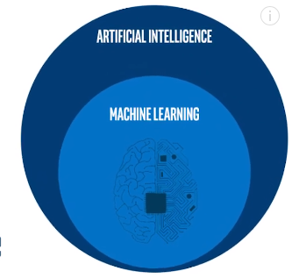
Machine LEARNING
Also known as ML.
Is a subset of Artificial Intelligence.

Slide 5
It is the set of algorithms that allow the computers to “learn” from the data without being explicitly programmed.
It uses statistical methods to enable machines to improve using a large amount of data like annotate pictures of different cats (whatever image is).
The Machine can then determine whether there is a cat in a new unseen image by comparing what it has seen before, just like humans. See the example below

Slide 7
The above is just an example of classification.
There’s a lot of ways computers “learn” from data to achieve an edge goal decided by the developer.

Slide 8
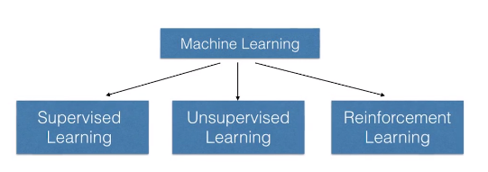
Machines “learn” from data either by using a Supervised, Semi-supervised or Unsupervised method. Which are all under a subset of machine learning called Deep Learning.

Slide 9
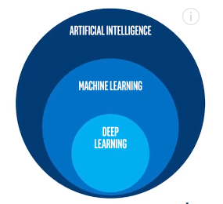

Slide 10
Deep Learning, also known as deep structure learning or hierarchical learning
Is a subset of Artificial Intelligence and Machine Learning.
The specification of deep learning is that the Neural Network has way more layers than the other machine learning subsets, it is way “deeper.

Slide 11
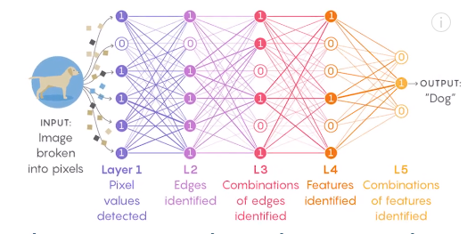

Slide 12
and this is the reason why “deep neural network requires a large amount of data.
Resulting in extremely powerful learning models capable of processing data in new ways, But this takes a lot of time and power to train for a machine.
It is basically connecting a lot of “neurons” together, just like the brain, assigning weights to each features.
It can then decide the correct output from any input it receives, connecting the dots together like a detective who links all the clues to find the guilty person.

Slide 13
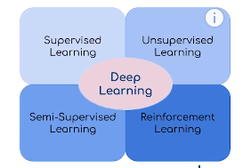
Learning this weights can be done using a Supervised, Semi-supervised or Unsupervised method.

Slide 14
Supervised learning is a type of machine learning where the algorithm learns from labeled training data.
In this approach, the model is trained using a dataset that includes both input features and corresponding output labels.
The goal is for the model to learn the mapping from inputs to outputs so that it can predict the labels for new, unseen data accurately.

Slide 15
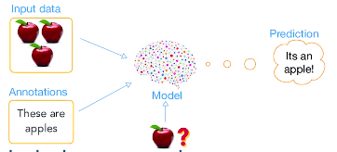

Slide 16
It infers a function from labeled training data consisting of a set of training examples.
In Supervised learning, each example is a pair consisting of an input object (typically a Vector) and desired output value (also called the supervisory signal).
This Supervised it’s mostly used for Regression and Classification problems.

Slide 17
SEVERAL MACHINE LEARNING ALGORITHMS CAN BE USED FOR REGRESSION PROBLEMS.
Linear Regression
Polynomial Regression
Ridge Regression (L2 Regularization)
Lasso Regression (L1 Regularization)
Elastic Net
Decision Trees
Random Forest
Gradient Boosting Machines (GBMs)
Support Vector Regression (SVR)
k-Nearest Neighbors (k-NN) Regression
Bayesian Regression

Slide 18
HERE ARE SEVERAL COMMONLY USED MACHINE LEARNING ALGORITHMS FOR CLASSIFICATION TASKS:
Logistic Regression
Decision Tree
Random Forest
Gradient Boosting Machines (GBMs)
Support Vector Machines (SVM)
k-Nearest Neighbors (k-NN)
Naive Bayes
Neural Networks
Convolutional Neural Networks (CNNs)
Recurrent Neural Networks (RNNs)
Ensemble Methods
XGBoost

Slide 19
1. Firstly:
I think to start in anything you must know the basic or general idea of ​​the field, so I list a few of the best videos I found that will give you a great first introduction of the terms you need to know to get started in the field.
- Learn the basics in a minute - What's AI - YouTube Playlist
(https://www.youtube.com/playlist?list=PLO4GrDnQanVe6F6MRJg_KO7JEoH-ukFzY)
Read some articles for the people preferring the reading path:
- 5 Beginner Friendly Steps to Learn Machine Learning and Data Science with Python - Daniel Bourke
(https://towardsdatascience.com/5-beginner-friendly-steps-to-learn-machine-learning-and-data-science-with-python-bf69e211ade5)
- What is Machine Learning? - Roberto Iriondo
(https://medium.com/towards-artificial-intelligence/what-is-machine-learning-ml-b58162f97ec7)
- Machine Learning for Beginners: An Introduction to Neural Networks - Victor Zhou
(https://towardsdatascience.com/machine-learning-for-beginners-an-introduction-to-neural-networks-d49f22d238f9)

Slide 20
THANK YOU FOR LISTENING

